Slide 1




EXECUTIVE PRESENTATION:
DATA-DRIVEN E-COMMERCE STRATEGY & RECOMMENDATIONS
Carlos Correa

Slide 2
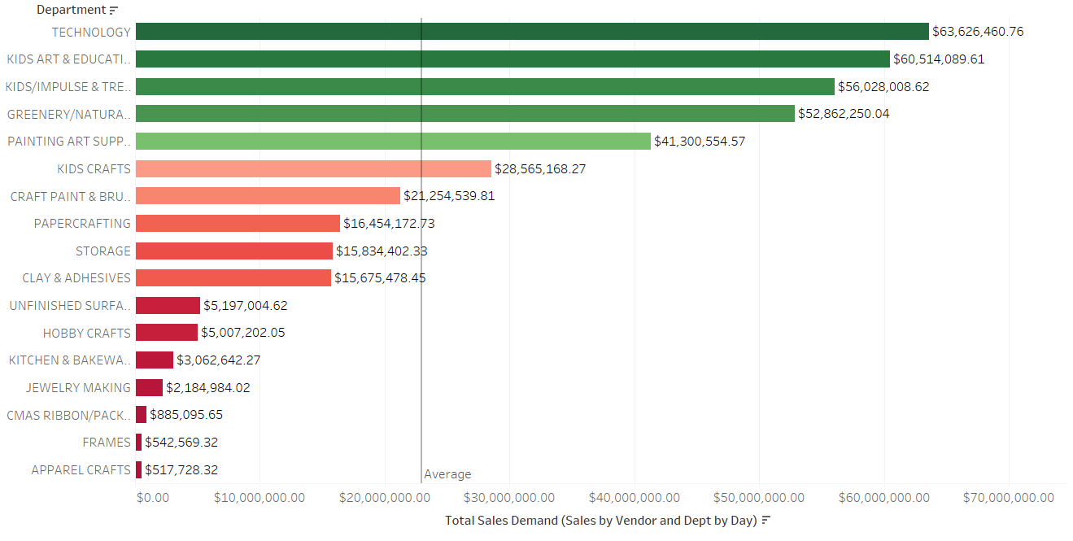



SALES & PROFITABILITY BY DEPARTMENT
WHICH DEPARTMENTS LEAD IN SALES AND PROFITABILITY?
Top performing departments:
Technology
Kids Art & Education
Kids/Impulse & Trend
Lowest-performing departments:
\CMAS Ribbon Packaging
Frames
Apparel Crafts
Should we allocate more resources to high-performing departments to sustain growth?
Can we improve profitability in underperforming departments through promotions or cost reductions?
Call to action:

Slide 3
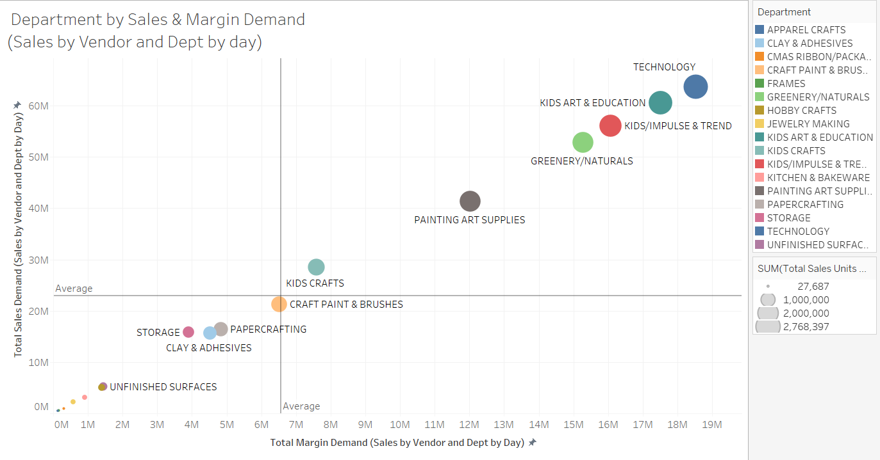


DEPARTMENT BY SALES & MARGIN DEMAND
HIGH-REVENUE AND HIGH-PROFIT
HOW DO SALES AND MARGIN DEMAND CORRELATE ACROSS DEPARTMENTS?
Below the trend line
Sales-driven growth but lower profitability,
requiring margin optimization
Should we push marketing efforts towards already successful categories?
Can we improve margin efficiency in categories that sell well but have lower profitability?
CALL TO ACTION:

Slide 4
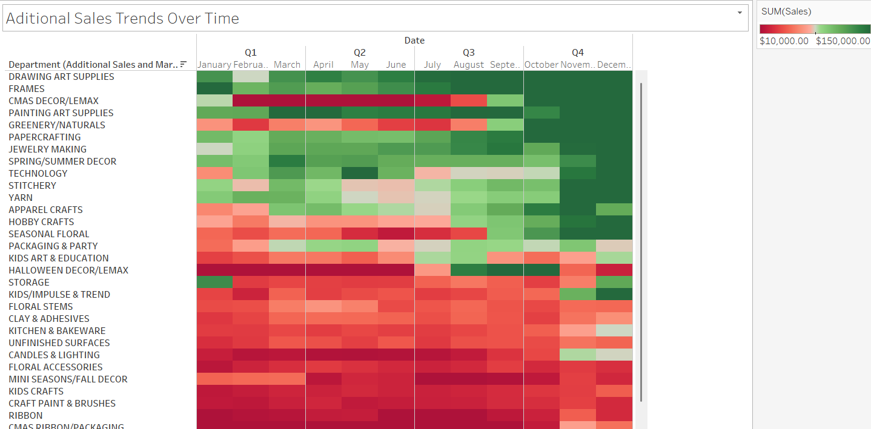



ADITIONAL SALES TRENDS OVER TIME
HOW DO SALES FLUCTUATE ACROSS TIME AND DEPARTMENTS?
THIS VISUALIZATION ALLOWS US TO DETECT SEASONAL TRENDS AND PEAK SALES PERIODS FOR EACH DEPARTMENT.
THE HEAT INTENSITY REVEALS WHICH MONTHS DRIVE THE HIGHEST REVENUE, HELPING OPTIMIZE INVENTORY AND PROMOTIONS.
CALL TO ACTION:
Do certain departments experience strong seasonal demand?
Can we align inventory and marketing efforts with high-sales periods?

Slide 5
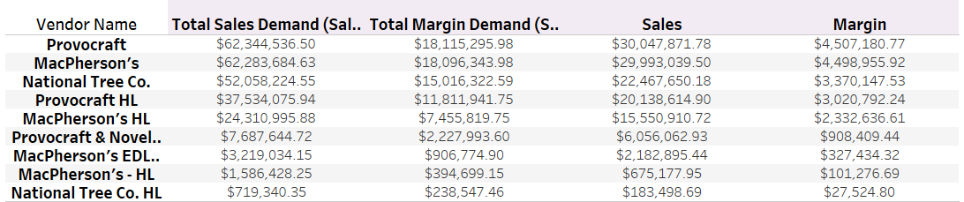


SALES, GROWTH & PROFITABILITY BY VENDOR
Top vendors based on
total sales demand and margin
WHICH VENDORS CONTRIBUTE THE MOST TO SALES AND PROFITABILITY?
LEADING CONTRIBUTORS TO COMPANY REVENUE
UNDERSTANDING THEIR SALES TRENDS CAN HELP NEGOTIATE BETTER PRICING AND COLLABORATION OPPORTUNITIES.
CALL TO ACTION:
Should we increase partnership efforts with high-performing vendors?
Are there opportunities to improve margins with lower-performing vendors?

Slide 6

Conclusion & Recommendations
01
02
Strengthen high-performing departments:
Optimize underperforming categories:
Focus marketing and inventory on Technology, Kids Art & Education, and Greenery & Natural.
Investigate ways to improve sales or profitability in CMAS Ribbon Packaging, Frames, and Apparel Crafts.
04
03
Enhance vendor relationships:
Leverage seasonality
Strengthen partnerships with top vendors like ProvoCraft and MacPherson’s while optimizing deals with others.
Adjust pricing and promotions to align with peak sales periods.

Slide 7
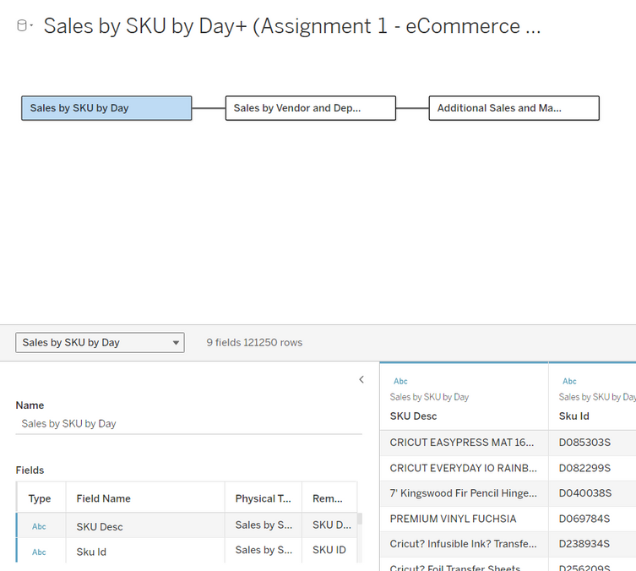
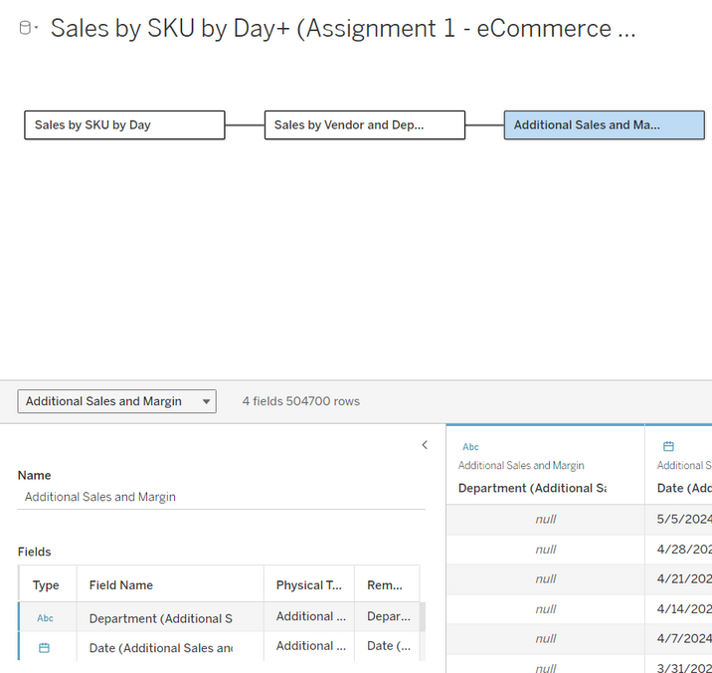
Appendix
DATA SOURCE

Slide 8
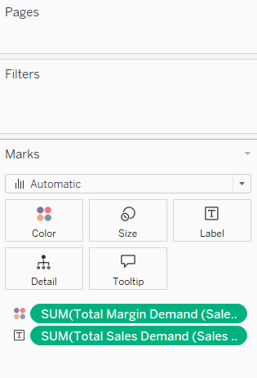
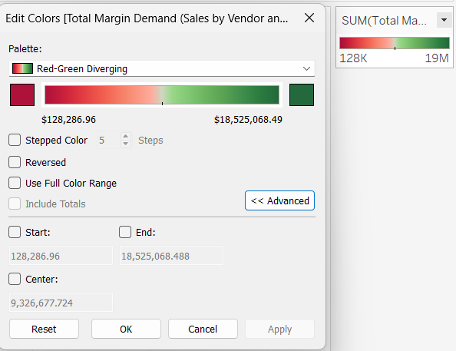

Appendix
SALES & PROFITABILITY BY DEPARTMENT

Slide 9
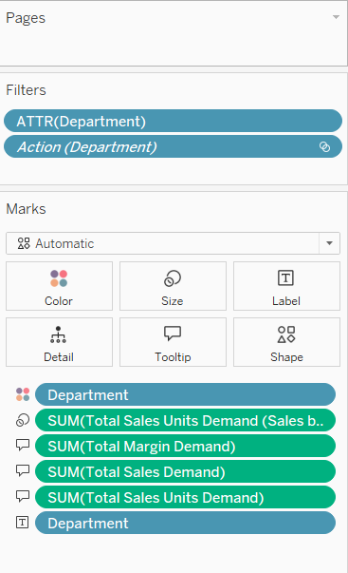

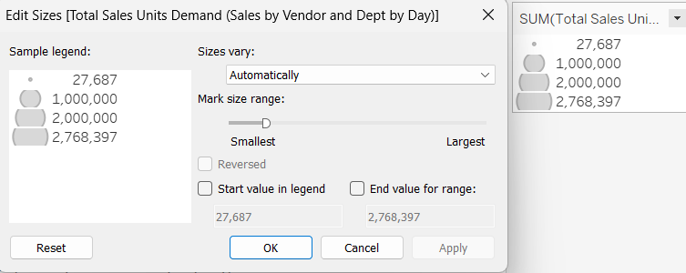
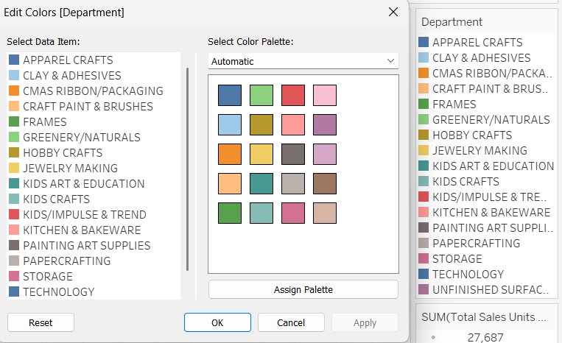
Appendix
DEPARTMENT BY SALES & MARGIN DEMAND

Slide 10
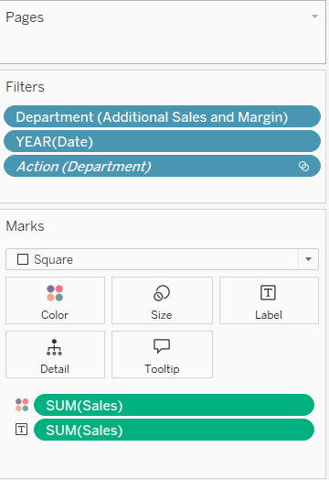

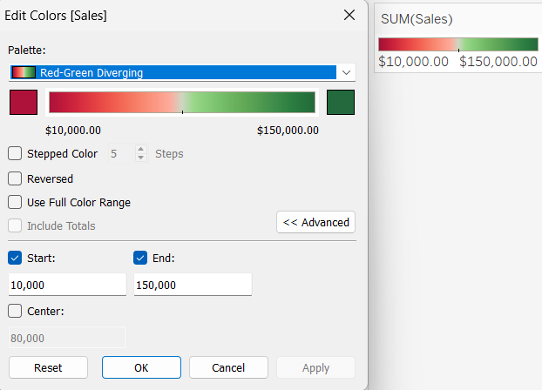
Appendix
ADITIONAL SALES TRENDS OVER TIME

Slide 11
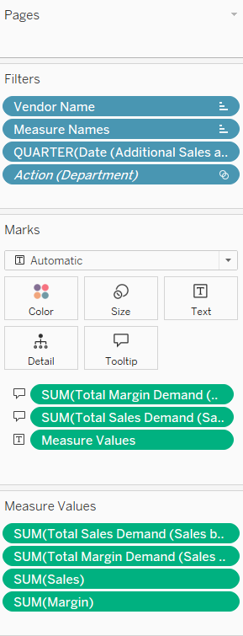
Appendix
SALES, GROWTH & PROFITABILITY BY VENDOR

Slide 12

THANK YOU

